Slide 1
Book Recommedation System Model
Submitted By Moksh Verma Submitted to Mrs. Rimpy

Slide 2
Introduction
Recommendation systems have evolved into intelligent algorithms that play a vital role in generating personalized recommendations, thereby simplifying the complexity of decision-making across a wide array of options. These systems are versatile, finding applications in diverse domains, where they offer personalized services that benefit both consumers and manufacturers. Specifically, in the realm of book recommendations, these systems leverage a combination of user and book databases to deliver highly relevant recommendations tailored to individual preferences.

Slide 3
Literature Review
-Suggestion of Similar Books using Machine Learning Approach
Content-Based Filtering: This approach recommends books based on the similarity between the content of the books and the user's preferences. Features such as genre, author, language, and keywords are used to make recommendations. (P. Melville, R. J. Mooney, & R. Nagarajan, 2002).
Collaborative Filtering: This technique recommends books based on the preferences of users with similar tastes. It can be user-based, where recommendations are made based on similar users, or item-based, where similar books are recommended based on the user's history (Y. Koren, 2009).

Slide 4
Project Description

Slide 5
Content Recommendation System
Content-based filtering techniques are instrumental in analyzing the similarity between items by examining their content, subsequently recommending similar items based on users' past preferences. This approach often employs classifier-based techniques or nearest neighbor methods to effectively match items to users, enhancing the recommendation process.

Slide 6
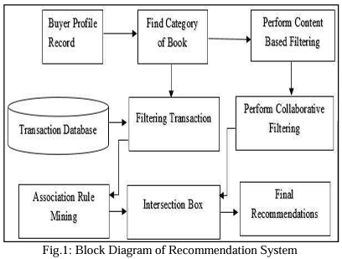

Slide 7
In the Following diagram: -
Trained Dataset: This dataset serves as the foundation for constructing the machine learning model.
Ensemble Learning (Cosine Similarity Algorithm): The system employs the Cosine Similarity, to build a robust and accurate model.
Testing Dataset: The model is then applied to a testing dataset to evaluate its effectiveness in predicting Book Suggestions.

Slide 8
Training Data Set

Slide 9

Books.csv

Slide 10
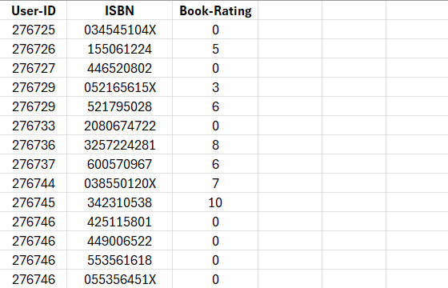
Ratings.csv

Slide 11
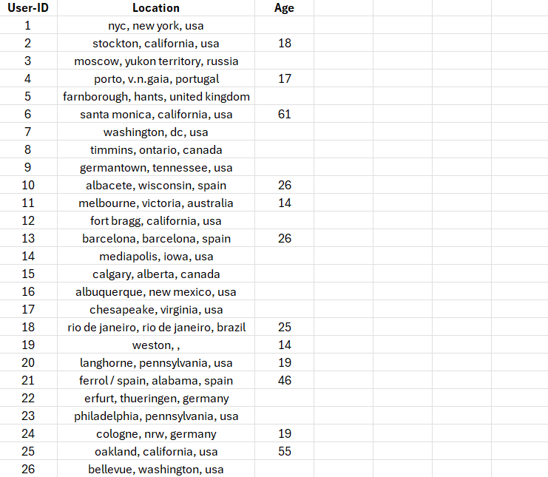
Users.csv

Slide 12
Modules Description

Slide 13
Numpy
NumPy, short for Numerical Python, is a fundamental library in the Python ecosystem for numerical computing. It provides support for large, multi-dimensional arrays and matrices, along with a collection of mathematical functions, making it an essential tool for scientific computing and data analysis.

Slide 14
Pandas
Pandas is a powerful and versatile library that simplifies tasks of data manipulation in Python . Pandas is built on top of the NumPy library and is particularly well-suited for working with tabular data, such as spreadsheets or SQL tables. Its versatility and ease of use make it an essential tool for data analysts, scientists, and engineers working with structured data in Python.

Slide 15
Matplotlib
Matplotlib is a comprehensive 2D plotting library for Python, widely utilised for creating static, animated, and interactive visualisations in various fields, including data analysis, scientific research, and machine learning. With a rich set of functionalities, Matplotlib empowers users to generate diverse and publication quality plots.

Slide 16
Scikit-Learn
scikit-learn is a powerful and user-friendly machine learning library for Python. Designed for efficiency and ease of use, scikit-learn provides simple and consistent interfaces for various machine learning tasks, making it a popular choice for both beginners and seasoned practitioners.

Slide 17
Output

Slide 18

Recommending Similar Books:

Slide 19
Conclusion

Slide 20
The primary goal of most recommendation systems is to predict the buyer's interests accurately and suggest books that align with those interests. This book recommendation system takes into account several parameters, such as the content and quality of the books, by leveraging collaborative filtering of ratings from other buyers. Additionally, the system employs an associative model to provide more robust recommendations.
One of the key advantages of this system is its offline nature, which eliminates performance issues commonly associated with real time recommendation systems. By building recommendations offline and storing them in the buyer's web profile, the system can efficiently generate personalized book suggestions without the need for real-time processing. This approach enhances the user experience by ensuring that recommendations are relevant, high-quality, and tailored to individual preferences.

